Slide 1
Plant Disease Fertilizer Recommendation System Using IBM Watson
Team: Nerd Engineers
B. Vishnu Priya
G.Medha Vyshnavi
G. Meenakshi Praharshitha
M. Tephillah Angelina

Slide 2
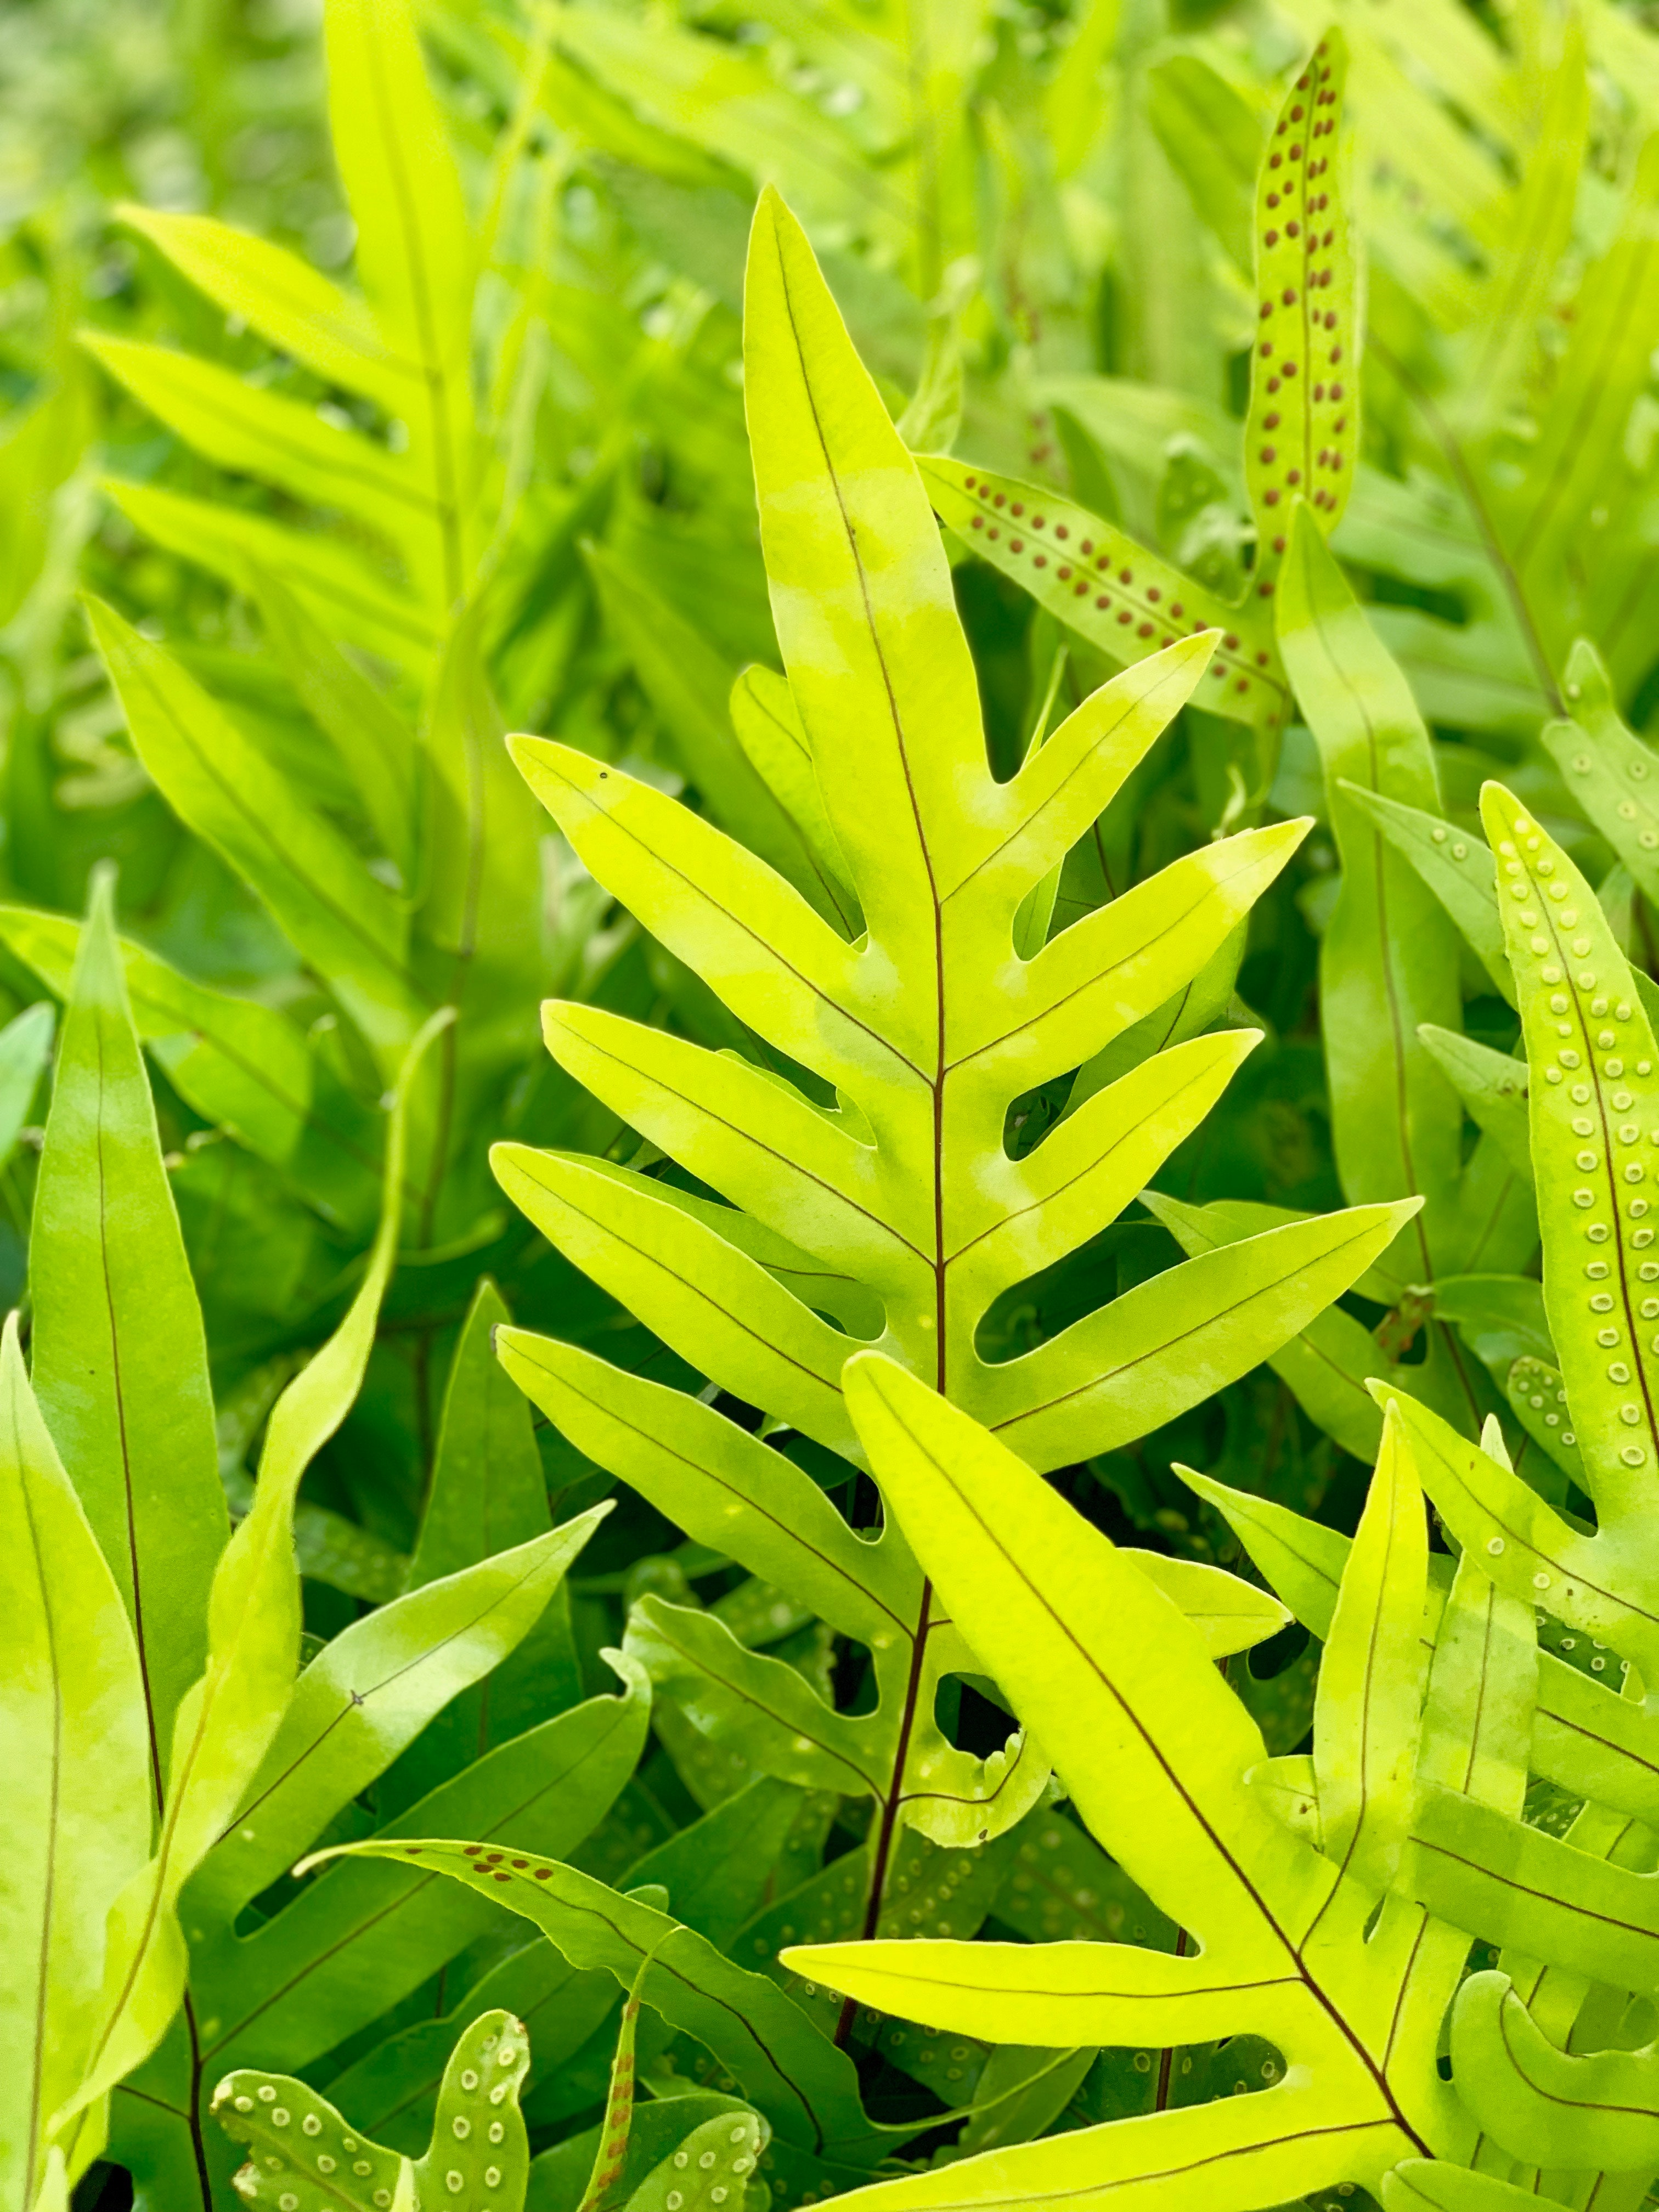
Agriculture is the most important sector in today’s life. Agriculture is the main aspect of country development. Many people lead their life from agriculture field, which gives fully related to agricultural products. Plant disease, especially on leaves, is one of the major factors of reductions in both quality and quantity of the food crops. In agricultural aspects, if the plant is affected by leaf diseases then it reduces the growth of the agricultural level. Finding the leaf disease is an important role of agriculture preservation. After pre-processing using a median filter, segmentation is done by Guided Active Contour method and finally, the leaf disease is identified by using Support Vector Machine. The disease-based similarity measure is used for fertilizer recommendation.

Slide 3
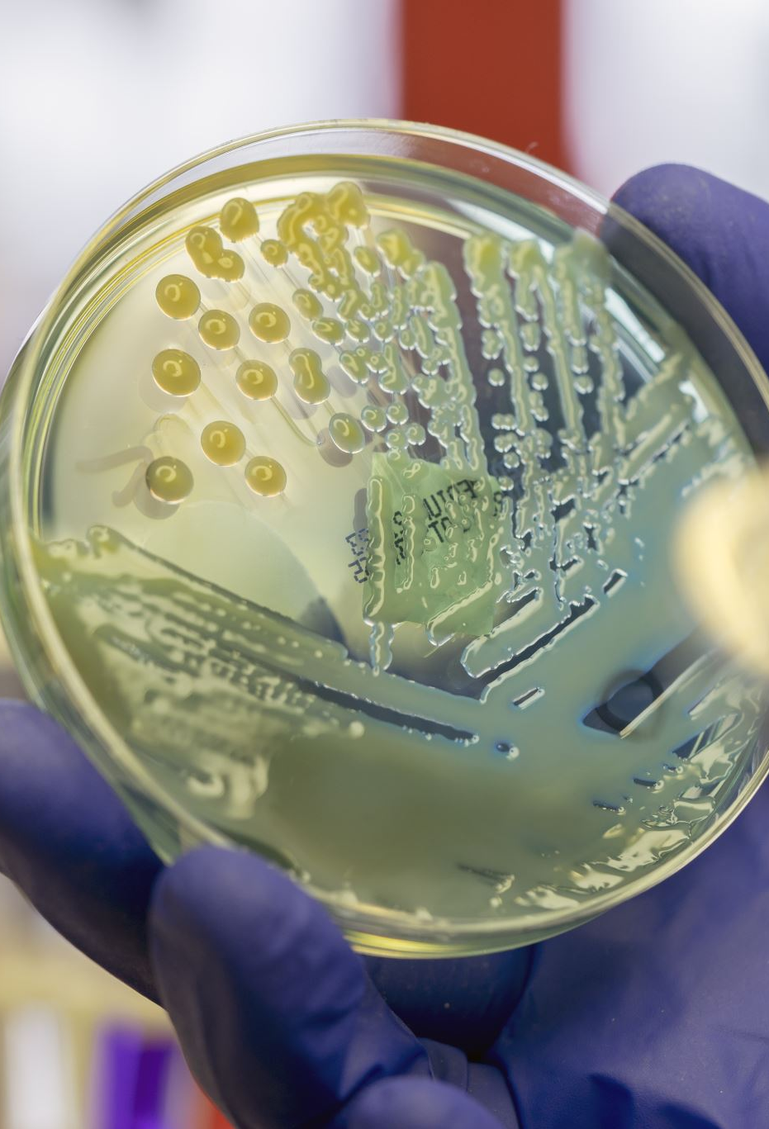
Detection and recognition of plant diseases using machine learning are very efficient in providing symptoms of identifying diseases at its earliest. Plant pathologists can analyze the digital images using digital image processing for diagnosis of plant diseases. Application of computer vision and image processing strategies simply assist farmers in all the regions of agriculture. Generally, the plant diseases are caused by the abnormal physiological functionalities of plants. Therefore, the characteristic symptoms are generated based on the differentiation between normal physiological functionalities and abnormal physiological functionalities of the plants. Mostly, the plant leaf diseases are caused by Pathogens which are positioned on the stems of the plants. These different symptoms and diseases of leaves are predicted by different methods in image processing. These different methods include different fundamental processes like segmentation, feature extraction and classification and so on. Mostly, the prediction and diagnosis of leaf diseases are depending on the segmentation such as segmenting the healthy tissues from diseased tissues of leaves.

Slide 4

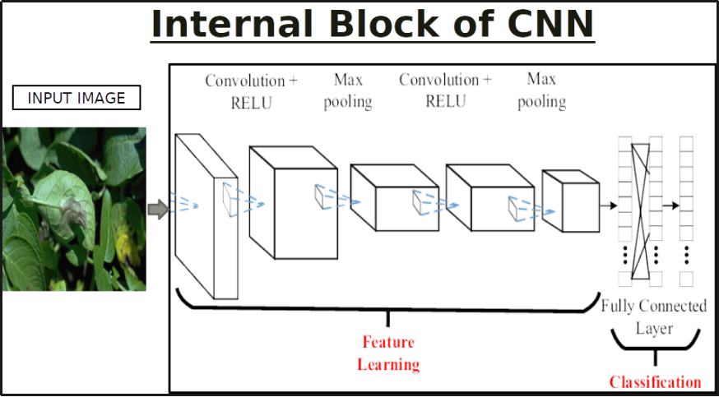

Project Objectives
Preprocess the images.
Applying CNN algorithm on the dataset.
How deep neural networks detect the disease.
You will be able to know how to find the accuracy of the model.
You will be able to Build web applications using the Flask framework.

Slide 5
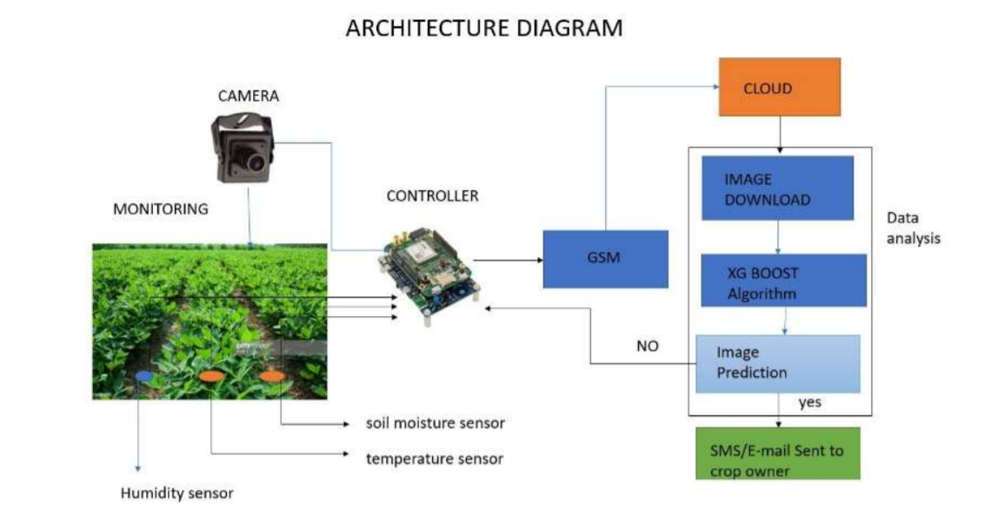

Slide 6
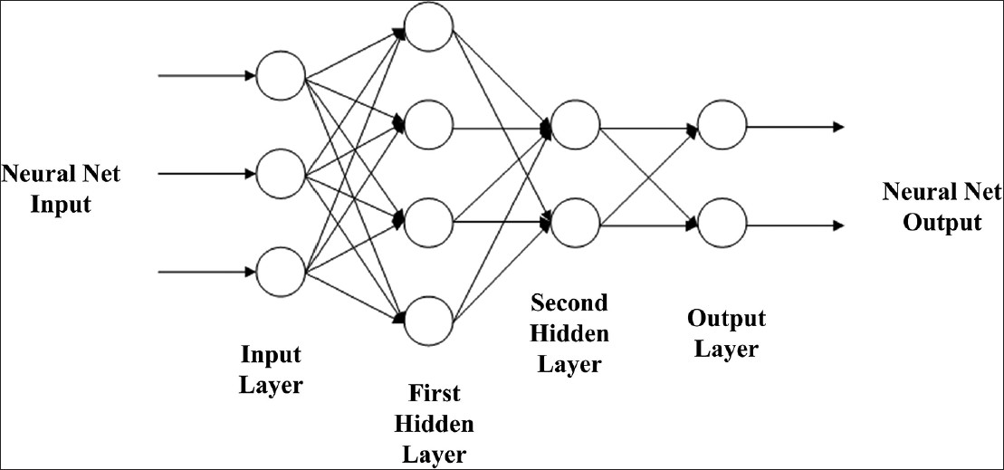
Model Building For Fruit & Vegetable
Disease Prediction
Import the model building Libraries
Initializing the model
Adding CNN Layers
Adding Hidden Layer
Adding Output Layer
Configure the Learning Process
Training and testing the model
Saving the model
This Photo by Unknown author is licensed under CC BY-SA.

Slide 7
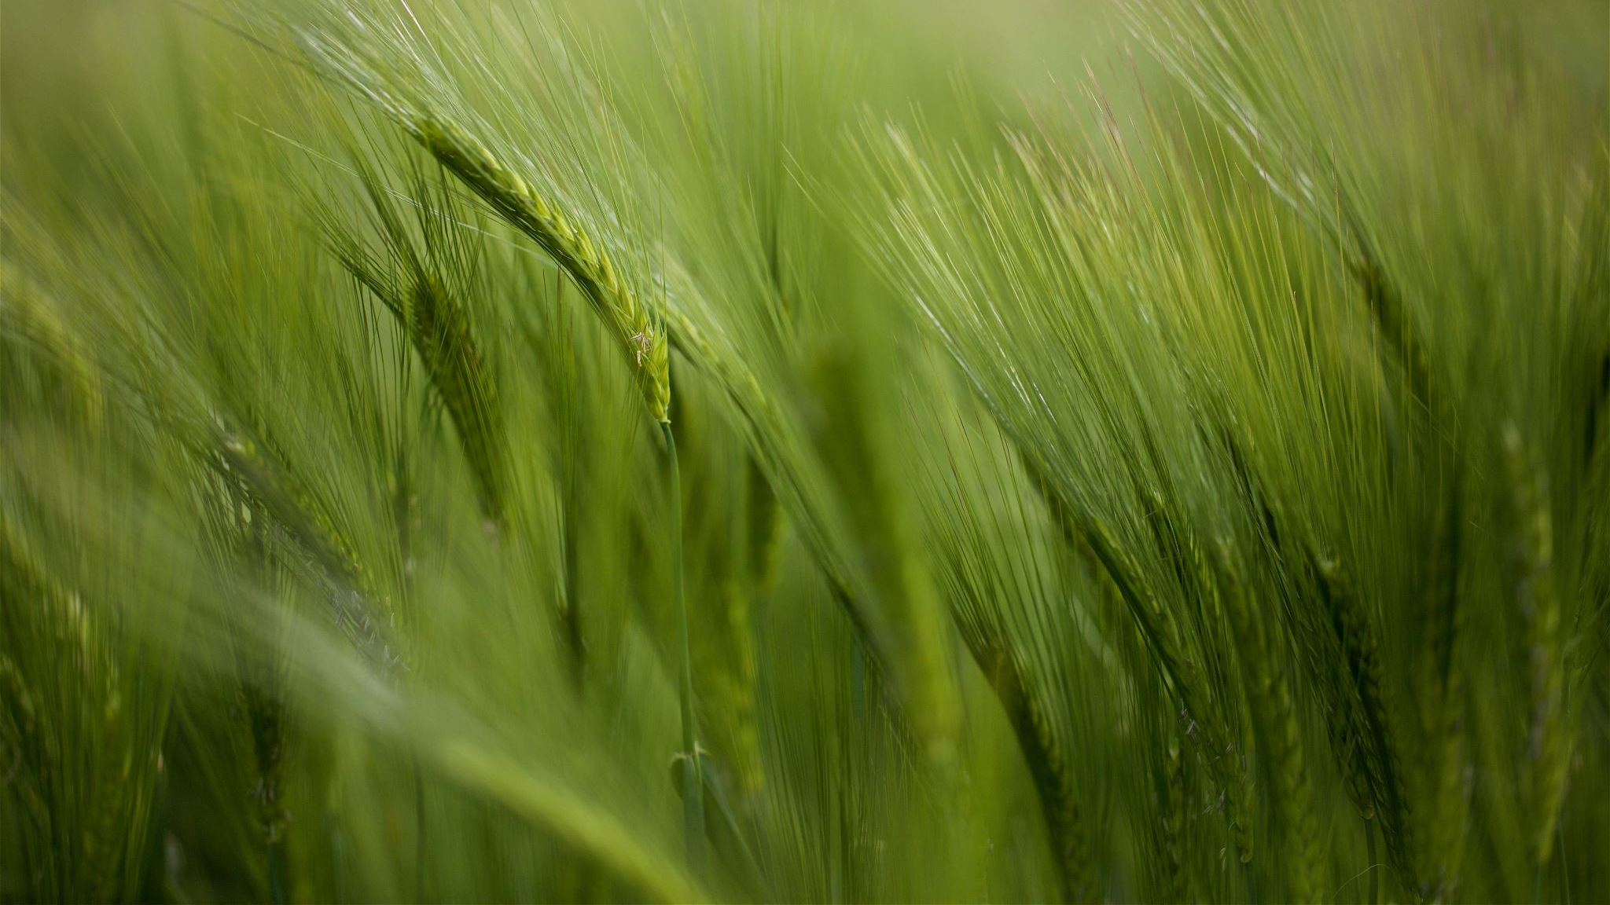
''FARMING ISN'T SOMETHING THAT CAN BE TAUGHT. EACH PLANT TELLS ITS OWN STORY THAT HAS TO BE READ REPEATEDLY.''

Slide 8

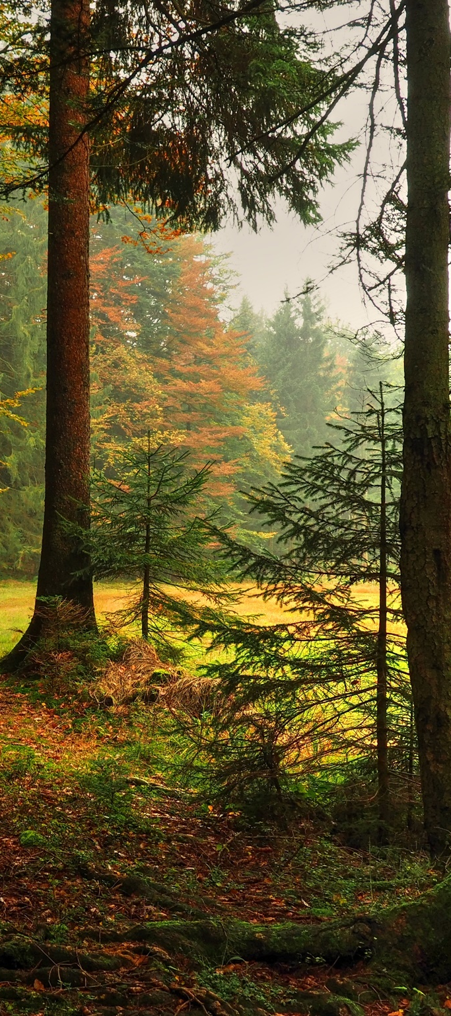
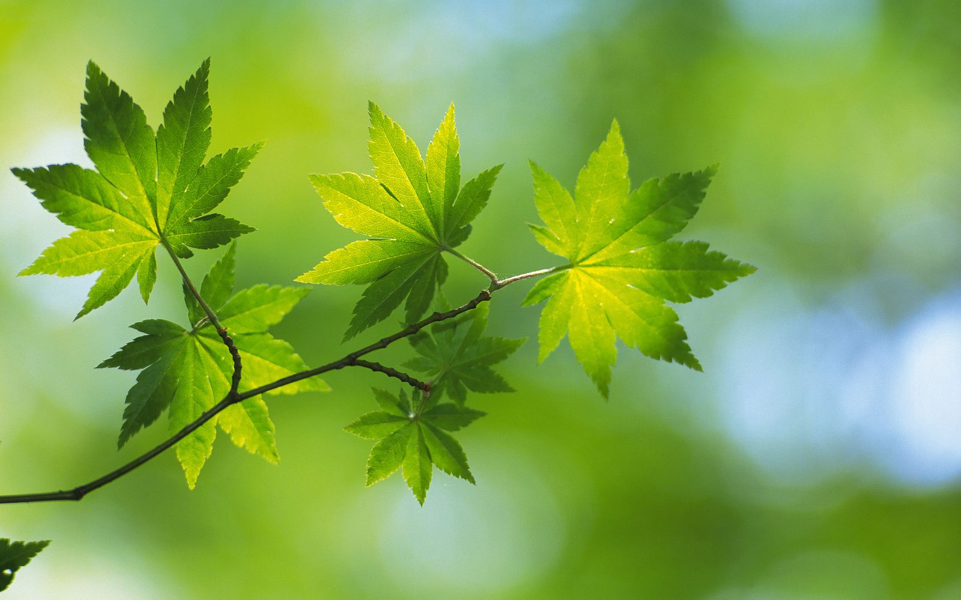
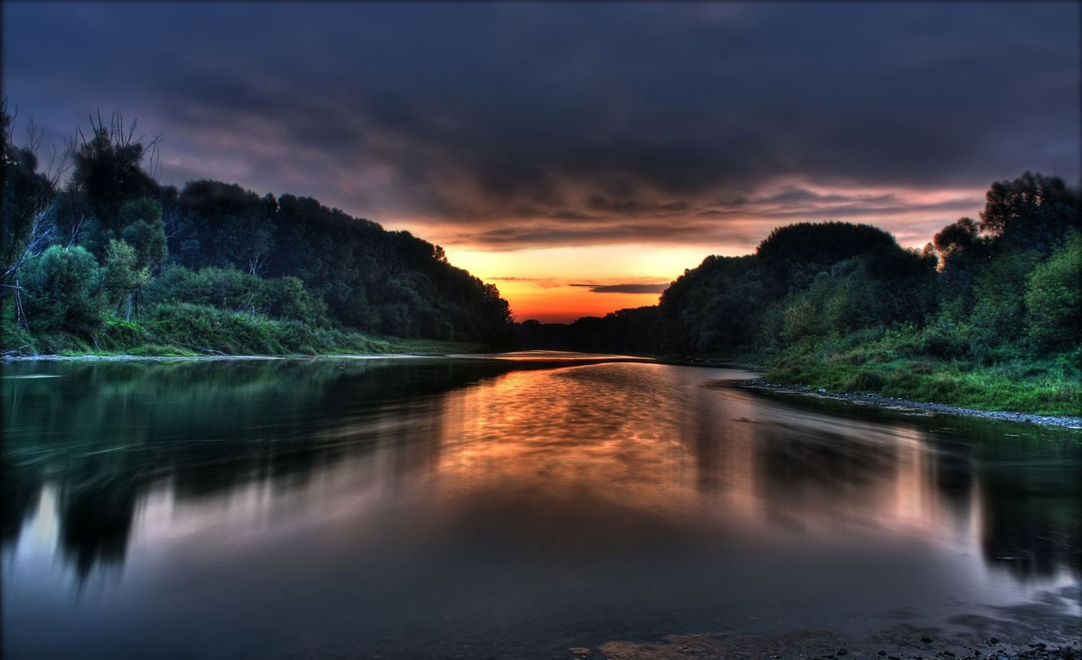
Thank You
This Photo by Unknown author is licensed under CC BY.
This Photo by Unknown author is licensed under CC BY.
This Photo by Unknown author is licensed under CC BY.
This Photo by Unknown author is licensed under CC BY-NC-ND.

